Slide 1
Step Into Java:
Elevens Card Game
Let’s Play!
Mr. Neat
Java

Slide 2
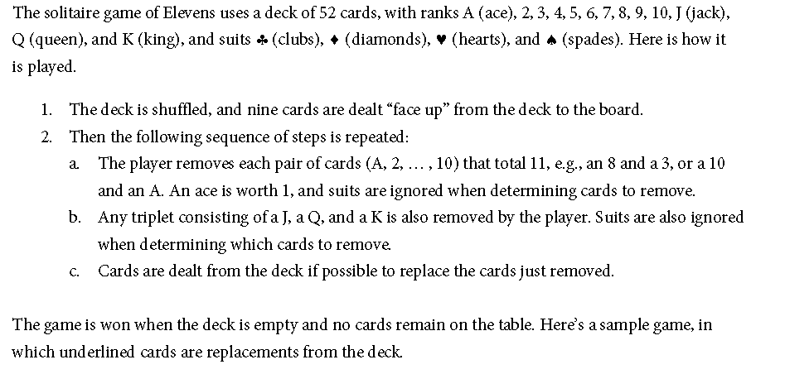
Elevens – Game Rules

Slide 3
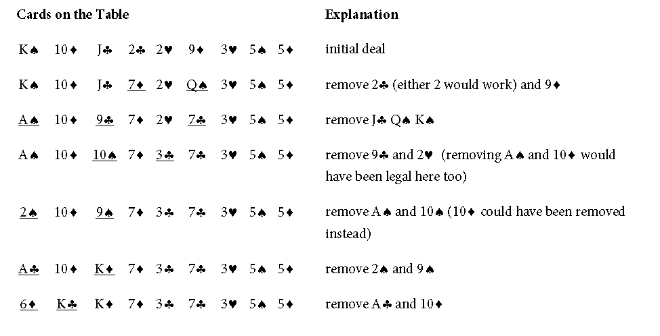
Elevens – Example

Slide 4
Lab
Play it!
Any strategy?

